Slide 1
Operating Systems (Client)‏
Lecture 8
System Monitoring and
Periodic Processes
Dr. Kevin Farrell

Slide 2
Lecture Overview
Introduction
Logging Policies
Linux Log Files
Syslog
References

Slide 3
What Entities Create Log Files?
The system daemons, the kernel, and various utilities all emit data that is logged
This data is eventually stored on your (finite-sized) disks.
Most of that data has a limited useful life and needs to be summarized, compressed, archived and eventually thrown away.

Slide 4
Logging Policies
Logging policies vary from site to site.
Four common schemes include the following:
  Throw away all data immediately.
  Reset log files at periodic intervals.
  Rotate log files, keeping data for a fixed time.
  Compress and archive logs to tape or other permanent media.

Slide 5
Factors Affecting Logging Policy
The correct choice for your site depends on how much disk space you have and how security conscious you are.
Even sites with an abundance of disk space must deal with the enormous growth of log files.
Whatever scheme you select, you should automate the maintenance of log files with the cron daemon. See a later lecture.

Slide 6
Throwing Away Log Files
Not recommended to throw away all logging info.
Sites that are subject to security problems routinely find that log files provide important evidence of break-ins.
Log files also helpful for alerting sysadmins to hardware and software problems.
In general, given a comfortable amount of disk space, you should keep data for at least a month.
In the real world, it may take this long for you to realize that your site has been compromised by a hacker and that you need to review the logs.
If you need to go back further into the past, you can recover older log files from your backup tapes.

Slide 7
Resetting Log Files
Allow log files to grow until they become bothersome, then delete their contents, and start them from zero.
Better than keeping no data at all, but does not guarantee that log entries will be retained for any particular length of time
Average disk usage may also be higher than with other management schemes.

Slide 8
Rotating Log Files
Many sites store each day’s log info separately, sometimes in a compressed format.
Daily files are kept for a specific period of time and then deleted. Useful to keep the log files uncompressed so that they can be easily searched with grep.
One solution is to dedicate a disk partition on a central logging host (for eg. /var/log) to log files. Then, compress data that’s more than a week old with gzip.
A policy which keeps logging info for a fixed period is known as “rotation.” In a rotation system, you keep backup files that are one day old, two days old, etc. Each day, a script or utility program renames the files to push older data toward the end of the chain.

Slide 9
Rotating Logs: An Example Script
For a log file called logfile, the backup copies might be called logfile.1, logfile.2, etc. If you keep three day’s worth of data, there will be a logfile.3 but no logfile.4. Every day, the data in logfile.3 is lost as logfile.2 overwrites it.
The following script implements such a rotation policy:
      #!/bin/sh
      cd /var/log
      mv logfile.2 logfile.3
      mv logfile.1 logfile.2
      mv logfile logfile.1
      cat /dev/null > logfile
      chmod 600 logfile

Slide 10
Rotating Logs: Standard Utilities
Most Linux distributions supply a very nice log rotation utility called logrotate
It’s much easier (and more reliable) than writing your own scripts and is worth seeking out and installing if your distribution doesn’t include it.

Slide 11
Rotating Logs: Ownership & Naming
Ownership information is important for some log files.
From cron, you may need to run your rotation script as the log files’ owner rather than as root. Or, you may need to add a chown command to the sequence, to change the ownership.
Some sites identify log files by date rather than by sequence number; for example: logfile.tues or logffle.aug26
This system is a little harder to implement, but useful if you frequently refer to old log files.
One useful idiom that doesn’t require any programming is:
  mv logfile logfile.`date +%Y.%m.%d`
This scheme has the advantage of making ls sort the log files chronologically.

Slide 12
Rotating Logs: Daemon Issues 1
Some daemons keep their log files open all the time. Because of the way the filesystem works, our example script cannot be used with such daemons.
Instead of flowing to the recreated logfile, log data will continue to go to logfile.1; the active reference to the original file persists even after the file has been renamed!
To install a new log file, you must either signal the daemon or kill and restart it.

Slide 13
Rotating Logs: Daemon Issues: Updated Example Script
Here is an updated example that uses both compression and signals:
    #!/bin/sh
    cd /var/log
    mv logfile.2.gz logfile3.gz
    mv logfile.1.gz logfile.2.gz
    mv logfile logfile.1
    cat /dev/null > logfile
    chmod 600 logflle
    kill -signal pid
    gzip logfile.1

Slide 14
Rotating Logs: Daemon PID
In this script, signal represents the appropriate signal for the program writing the log file; pid is its Process ID.
The signal can be hard-coded into the script, but you must determine the PID of the daemon dynamically, either by:
  reading a file that the daemon has left around for you; for e.g., /var/run/syslogd.pid (described later), or
  by using the killall variant of kill, which can look up the PID in the process table
For example, the command
  killall -e -HUP syslogd
is equivalent to
  kill -HUP `cat /var/run/syslogd.pid`

Slide 15
Archiving Log Files: Reasons
Some sites must archive all accounting data and log files as a matter of policy, perhaps to provide data for a potential audit.
In this situation, log files should be first rotated on disk; then written to tape or other permanent media.
This scheme gives you fast access to recent data.
Log files should always be included as part of your regular backup sequence.
Because they contain info that is vital for investigating security incidents => include them in the most frequent backup schedule.

Slide 16
Archiving Log Files: Problems
Log files change frequently, so they can represent a significant portion of the system information that is stored on incremental backups.
Therefore, it's important to keep the interaction between your logging policy and your backup policy in mind when designing both.
In addition to being stored as part of regular backups, logs can also be archived to a separate tape series. Separate tapes won’t interfere with recycling tapes for standard incremental backups.
If using separate tapes, a good suggestion is to use the tar format, and write a script to automate the backup scheme.

Slide 17
Linux Log Files: Overview
Introduction
Common Log Files in Popular Distributions
Log File Properties
Special Log Files

Slide 18
Linux Log Files
Although each distribution has its own way of naming and dividing up the log files, Linux packages generally send their logging information to files in the /var/log directory. On some distributions, logs are also stored in /var/adm.
Nowadays, most programs actually send their log entries to a central clearing system called syslog (see later)‏
The default syslog configuration typically dumps most of these messages into some file or subdirectory in
/var/log. The syslog configuration file, /etc/syslog.conf, dictates the location (see later).

Slide 19
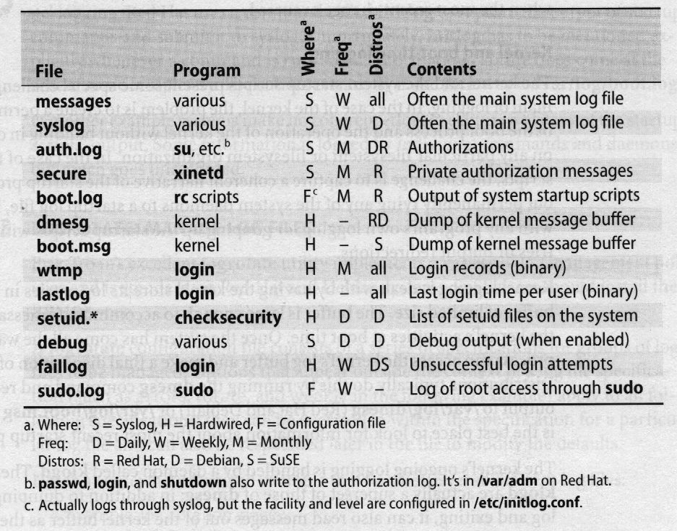
Common Log Files in popular Distributions
Table 1: Common Log files across the 3 most popular distributions

Slide 20
Common Log Files: Explanation
The previous slide compiles info. about some common log files on the popular distributions. Specifically, it lists:
  The log files themselves
  The program that creates each
  An indication of how each filename is specified. S for programs that use syslog, F for programs that use a config. file, and H if the filename is hard-wired in code of the program.
  The frequency of attention/clean-up considered to be reasonable
  Some popular distributions that use the log file
  A description of each file’s contents
Filenames are relative to /var/log unless otherwise noted.

Slide 21
Log Files: Properties
Log files are generally owned by root, although conventions for the ownership and mode of log files vary among distributions.
Most logs should be given mode 600 (read and write for the owner only) because their contents are potentially useful to hackers.
At the very least, the secure, auth.log, and sudo.log files should be off limits to casual browsing. Never give write permission on any log file to any one but the owner.
Note that many of the log files in Table 1 are maintained by syslog but that the default syslog configuration varies among systems. With a more consistent /etc/syslog.conf file, the log files would look relatively similar among Linux distributions.

Slide 22
Special Log Files 1
Most logs are text files to which lines are written when “interesting” events occur. A few of the logs listed in Table 1 have a rather different context, however.
/var/log/wtmp:
  contains a record of users’ logins/logouts as well as entries that indicate system reboots/shutdowns.
  It’s a fairly generic log file in that new entries are simply added to the end of the file.
  However, the wtmp file is maintained in a binary format. Use the last command to decode the info.
  Despite its unusual format, the wtmp file should be rotated or truncated like any other log file because its natural tendency is to grow without limit.

Slide 23
Special Log Files 2
/var/log/lastlog:
  Contains similar info to /var/log/wtmp, but it records only the time of last login for each user
  It is a sparse, binary file that is indexed by the UID
  lastlog doesn’t need to be rotated because its size stays constant unless new users log in.

Slide 24
Kernel & Boot-Time Logging: Overview
Introduction
Mechanism
Ongoing Logging of a Running System
Duplication of Messages in Different Log Files
Console Management
Start-Up Script Logging

Slide 25
Kernel & Boot-Time Logging: Introduction
The kernel and the system start-up scripts present some special challenges in the domain of logging.
In the case of the kernel, the problem is to create a permanent record of the boot process and the operation of the kernel without building in dependencies on any particular filesystem or filesystem organisation.
In the case of the start-up scripts, the challenge is to capture a coherent narrative of the start-up procedure without permanently tying any of the system daemons to a start-up log file, interfering with any program’s own logging, or messing up the start-up scripts with double entries or output redirections.

Slide 26
Kernel and Boot-Time Logging: Mechanism
Kernel logging is dealt with by having the kernel store its log entries in an internal buffer of limited size – the “ring buffer”
The buffer is large enough to accommodate messages about all the kernel’s activities at boot time.
Once the system has fully booted up, a user process can access the kernel ring buffer and make a final disposition of its contents.
Distributions typically do this by running the dmesg command and redirecting its output to /var/log/dmesg (Red Hat, Mandrake and Debian) or /var/log/boot.msg (SuSE).
This is the best place to look for information about the most recent startup process.

Slide 27
Kernel and Boot-Time Logging:
Ongoing Logging
The kernel's ongoing logging is handled by a daemon called klogd
The functions of klogd are actually a superset of those of dmesg:
  in addition to dumping the kernel log and exiting, it can also read messages out of the kernel buffer as they are generated and pass them along to a file or to syslog.
  In normal operation, klogd runs in this latter mode; syslog processes the messages according to the instructions for the syslog “kern” facility
Note: the “kern” facility is a syslog facility for logging kernel messages at various levels of verbosity

Slide 28
Kernel and Boot-Time Logging: Duplication
The popular distributions’ startup scripts do not use the dmesg “-c” flag when they make their initial dump of log messages, so the kernel’s message buffer is read but not reset. (-c = clear the kernel buffer)‏
When klogd starts up, it finds the same set of messages seen by dmesg in the buffer and submits them to syslog.
For this reason, some entries appear in both the dmesg or boot.msg file and in another, syslog-managed file such as /var/log/messages

Slide 29
Kernel and Boot-Time Logging:
Console Management
Another issue in kernel logging is the appropriate management of the system console.
As the system is booting, it’s important for all the output to come to the console (so that it can be viewed).
However, once the system is up, console messages may be more an annoyance than a help, particularly if the console is used for logins.
Both dmesg and klogd let you set the kernel’s console logging level with a command-line flag. Level 7 is the most verbose and includes debugging info. Level 1 includes only panic messages (the lower-numbered levels are the most severe). For example for moderate info:
  # sudo dmesg -n 2
All kernel messages continue to go to the central buffer (and to syslog) regardless of whether they are forwarded to the console or not.

Slide 30
Kernel and Boot-Time Logging:
Start-Up Scripts
Logging for the system startup scripts is unfortunately not as well managed as kernel logging. Red Hat and Mandrake use a command called initlog to capture the output of startup commands and submit it to syslog.
Unfortunately, initlog has to be mentioned explicitly whenever a command is run, so the information capture does come at the cost of some complexity. The entries eventually make their way to /var/log/boot.log.
Other popular distributions make no coherent effort to capture a history of the startup scripts’ output. Some information is logged by individual commands and daemons, but much goes unrecorded.

Slide 31
Syslog: The System Event Logger: Overview
Introduction
Components
Operation
Configuring syslogd
Configuration Examples with Output
Designing a Logging Scheme
Software that uses Syslog

Slide 32
Syslog: Introduction
Originally written by Eric Allman
A comprehensive logging system
It has two important functions:
  to liberate programmers from the tedium of writing log files
  to put administrators in control of logging.
Before syslog, every program was free to make up its own logging policy. Sysadmins had no control over what info. was kept or where it was stored.
Syslog is quite flexible. It allows messages to be sorted by their source and importance (“severity level”), and routed to a variety of destinations: log files, users’ terminals, or even other machines.
Syslog’s ability to centralise the logging for a network is one of its most valuable features.

Slide 33
Syslog: Components
Syslog consists of three parts:
syslogd: the logging daemon (along with its config file, /etc/syslog.conf)‏
openlog et al.: library routines that submit messages to syslogd
logger: a user-level command that submits log entries from the shell

Slide 34
Syslog: Operation
syslogd is started at boot time and runs continuously; it cannot be managed with inetd. Programs that are syslog-aware write log entries (by using the syslog library routine) to the special file
/dev/log, a UNIX domain socket.
syslogd reads messages from /dev/log, consults its configuration file, and dispatches each message to the appropriate destinations.
The kernel logging daemon, klogd, is responsible for retrieving messages from the kernel ring buffer and forwarding them to syslogd.
A hangup signal (HUP, signal 1) causes syslogd to close its log files, re-read its configuration file, and start logging again.
If you modify /etc/syslog.conf, you must send a hangup signal to syslogd to make your changes take effect.
A TERM signal causes syslogd to exit.

Slide 35
Syslog: Operation continued
syslogd writes its process ID to the file /var/run/syslogd.pid
This convention makes it easy to send signals to syslogd from a script.
For example, the following command sends a hangup signal:
  # kill -HUP `/bin/cat /var/run/syslogd.pid`
Trying to compress or modify a log file that syslogd has opened for writing is not healthy and has unpredictable results.
The proper procedure is to move the old log aside, recreate the log with the same ownerships and permissions, and then send a HUP signal to syslogd.
This procedure is easily implemented with logrotate. (See Linux Admin Handbook, page 205 for an example).

Slide 36
Syslog: Configuration
The configuration file /etc/syslog.conf controls syslogd's behavior.
It is a text file with a relatively simple format.
Blank lines and lines with a pound sign (#) in column one are ignored. The basic format is:
  selector <Tab> action
For example, the line
  mail.info /var/log/maillog
would cause messages from the email system to be saved in the file /var/log/maillog.

Slide 37
Syslog: Configuration: Selectors 1
Selectors identify the program (“facility”) that is sending a log message and the message’s severity level with the syntax, facility.level
Both facility names and severity levels must be chosen from a short list of defined values; programs can't make up their own.
Facilities are defined for the kernel, for common groups of utilities, and for locally written programs. Everything else is classified under the generic facility “user.”
Selectors can contain the special keywords * and none, meaning all or nothing, respectively.
A selector can include multiple facilities separated with commas. Multiple selectors can also be combined with semicolons.

Slide 38
Syslog: Configuration: Selectors 2
In general, selectors are logically ORed together; a message matching any selector will be subject to the line’s action.
However, a selector with a level of none excludes the listed facilities regardless of what other selectors on the same line may say.
Here are some examples of ways to format and combine selectors:
  facility.level action
  facility1,facility2.level action
  facility1.level1;facility2.level2 action
  *.level action
  *.level;badfacility.none action

Slide 39
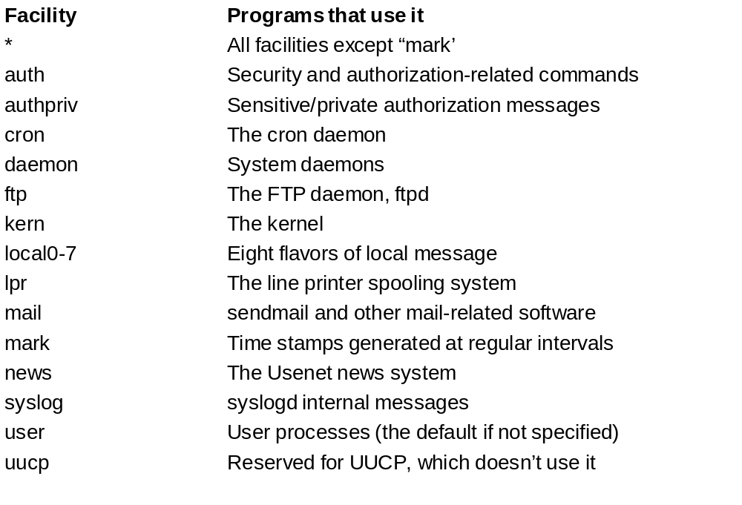
Syslog: Configuration: Facilities
Table 2: Valid Syslog Facility Names

Slide 40
Syslog: Configuration: Timestamps
syslogd itself produces time stamp messages, which are logged if the ““mark” facility appears in syslog.conf to specify a destination for them.
Time stamps can help you determine, for example, that your machine crashed between 3:00 and 3:20 am., not just “‘some time last night.”
This information can be very useful when you are debugging problems that seem to occur regularly.
For example, many sites have experienced mysterious crashes when the housekeeping staff plugged in vacuum cleaners late at night, tripping the circuit breakers!!!
There are various levels of severity for logging: see next slide

Slide 41
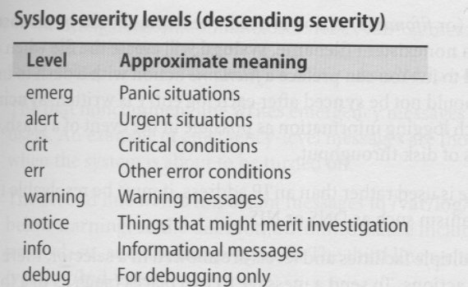
Syslog: Configuration: Severity Levels
A severity level means logging of info at that level and at all levels below that level.

Slide 42
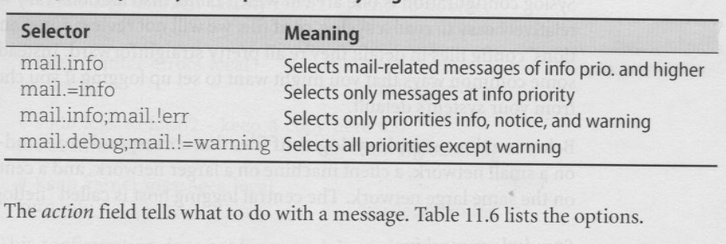
Syslog: Config: Severity Level Qualifiers
One can log at precisely the defined priority (severity) and only that priority, using the symbols “=” and “!”

Slide 43
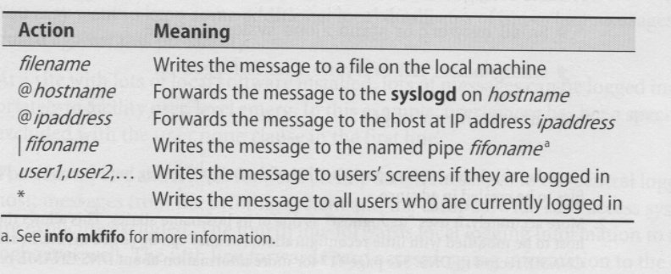
Syslog: Config: Actions
The action field tells what to do with a message:

Slide 44
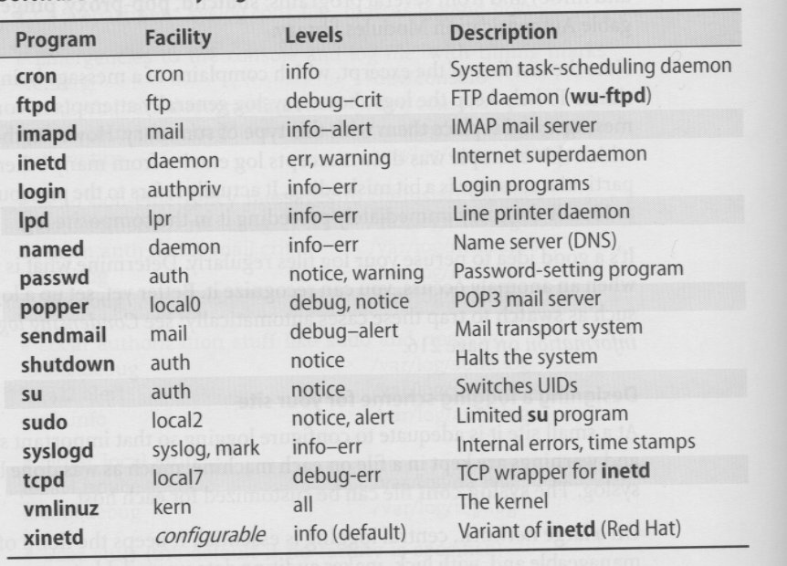
Syslog: Software that uses it
Table below lists some programs that use syslog, the facilities and levels they log to, and a brief description of each program

Slide 45
Syslog: Configuration Examples + Output
From our running Mandrake Linux system in E202!

Slide 46
Syslog: Condensing Log Files
Syslog is great for sorting and routing log messages, but the end product is still a group of log files.
They may contain all kinds of useful info., and need to be analysed regularly by the Sysadmin to detect system problems.
However, another layer of software is needed to perform this analysis properly
A variety of fre tools are available to fill this niche, and most of them are quite similar:
  They scan recent log entires, match them agains a database of regular expressions, and process the important messages in some attention-getting way.
  Some tools mail a report to the sysadmin; others can be configured to make noise, print log entires in different colours or page you!

Slide 47
References
“Linux Administration Handbook”, by Nemeth, Snyder & Hein (Prentice Hall, 2002)‏
Swatch utility: http://www.oit.ucsb.edu/~eta/swatch
Logcheck utility: http://www.psionic.com/abacus/logcheck

